Slide 1
Enabling Docker in Openstack
Ingkatit Aroonsakul (Ohm) 陈蓝林 Yang TianYu (Simon) 杨天宇

Slide 2
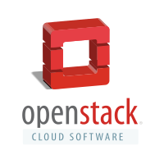
OpenStack
OpenStack is a Cloud operating system controlling large pools of compute, storage, and networking resources throughout a data center. It is manage by an administrator through a web interface dashboards.
In the current release (Mitaka),OpenStack is consisted of 17 components:
Nova, Glance, Swift, Horizon, Keystone, Neutron, Cinder, Heat, Ceilometer, Trove, Sahara, Ironic, Zaqar, Manila, Designate, Barbican, and Searchlight

Slide 3
OpenStack
Nova (OpenStack Compute) is a cloud computing fabric controller, which is the main part of an “Infrastructure as a Service” (IaaS). It is designed to manage and automate pools of computer resources and can wok with widely available virtualization technologies to control virtual machines using Hypervisor as VM ware.
Glance (OpenStack Image) provides discovery, registration, and delivery services for disk and server images. Stored images can be used as a template.

Slide 4
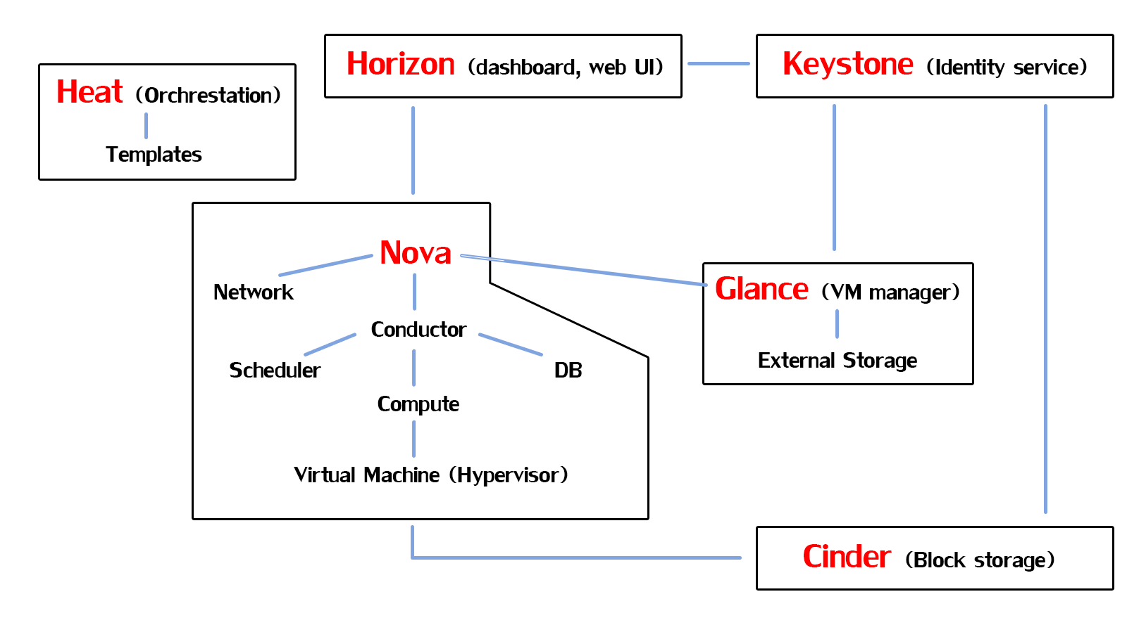
OpenStack

Slide 5
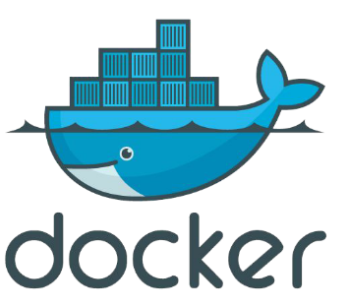
Docker
Docker is an open-source engine which automates the deployment of application inside a software containers, which are independent of hardware , language, framework, packing system, and host provider.
The software container to be used in this task is the Linux Containers (LXC).

Slide 6
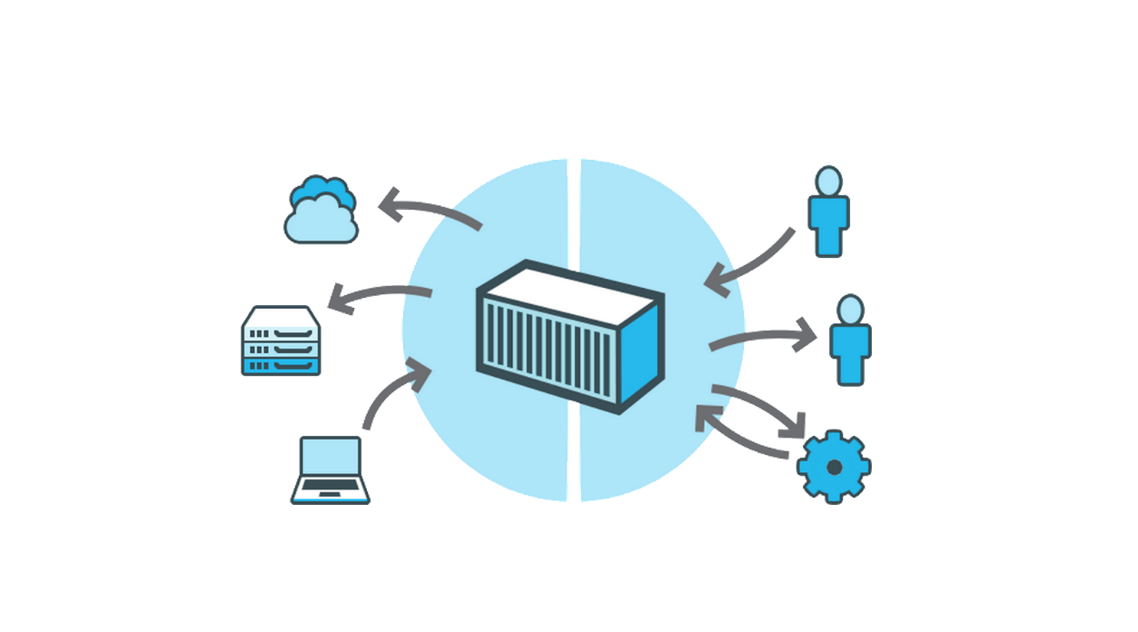
Docker
Docker when used behind “Nova” makes it much more powerful since it’s then possible to manage hundreds of containers

Slide 7
Docker
Advantages of Docker over other container technologies:
Process-level API: Docker can collect the standard outputs and inputs of the process running in each container for logging or direct interaction, it allows blocking on a container until it exits, setting its environment, and other process-oriented primitives which don’t fit well in libvirt’s abstraction.
Advanced change control at the file system level
Image Portability: Docker images are designed to be portable across infrastructures.
Build Facility: Automate the assembly of a container from an application’s source code

Slide 8
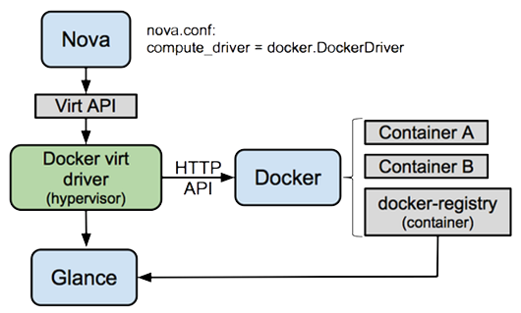
How Nova Hypervisor works
Nova driver embeds a tiny HTTP clients communicating with the Docker Internal Rest API through a UNIX socket
It uses the HTTP API to control containers and fetch information about them
The driver will fetch images from the OpenStack Image Service (Glance) and load them into the Docker file system. Images may be placed in Glance by exporting them from Docker using the “docker save” command
Nova Hypervisor process [image taken from https://wiki.openstack.org/wiki/Docker]

Slide 9
Enabling Docker in OpenStack
Installing Docker
Add Nova to the docker group and restart the compute service to recognizes the changes made. This is to allow Nova to communicate with Docker over its local socket
Command:
Install the Driver
Command
Install required modules
Command
Usermod –aG docker nova
Service openstack-nova-compute restart
Pip install –e git+https://github.com/openstack/nova-docker#egg=novadocker
cd src/novadocker/
Python setup.pyinstall

Slide 10
Enabling Docker in OpenStack
Nova Configuration
Configuration to Nova must be made to use the Docker virtual driver
Edit the configuration file /etc/nova.conf according to the following:
[DEFAULT]
Compute_driver = nova.virt.docker.DockerDriver
Compute_driver = libvirt.LibvirtDriver //To enable Linux container
[libvirt]
Virt_type = lxc

Slide 11
Enabling Docker in OpenStack
If the directory /etc/nova/rootwarp.d , if it does not already exist, and create a file “docker.filters” in that directory with the following content
# nova-rootwrap command filters for setting up network in the docker driver
# This file should be owned by (and only-writeable by) the root user
[Filters]
# nova/virt/docker/driver.py: 'ln', '-sf', '/var/run/netns/.*'
ln: CommandFilter, /bin/ln, root

Slide 12
Enabling Docker in OpenStack
Glance Configuration
To support the “docker” container format, Glance must be configured. The default ones should be left to not break an existing Glance install
[DEFAULT]
container_formats = ami,ari,aki,bare,ovf,docker

Slide 13
References
https://en.wikipedia.org/wiki/OpenStack
https://wiki.openstack.org/wiki/Docker
https://www.youtube.com/watch?v=S7NVloq0EBc

